Slide 1
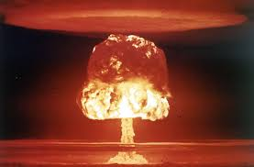
Los Alamos
Primer
Quantum Physics
Fall 2025
Ela Algar and Katherine Russell

Slide 2
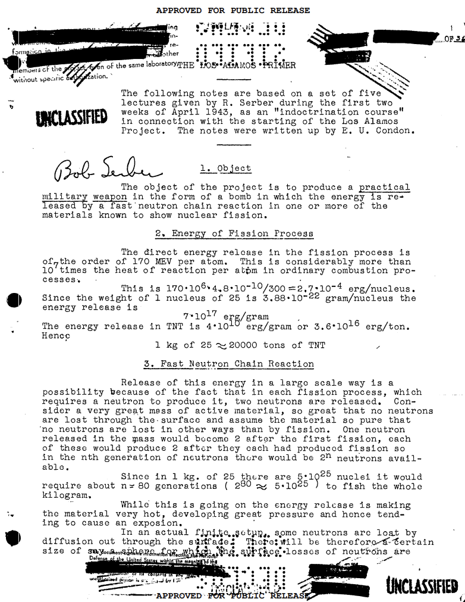
Introduction to the Primer

Slide 3
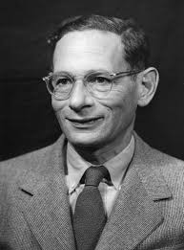

Robert Serber
American (Philadelphia native) Physicist recruited to Manhattan Project.
Explained basic principles and goals to incoming staff.
Five lectures about atomic bomb
E.U. Condon summarized Serber’s lectures in the Los Alamos Primer.

Slide 4
Why Fission?

Slide 5
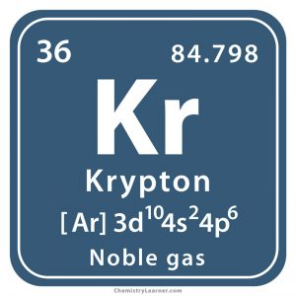


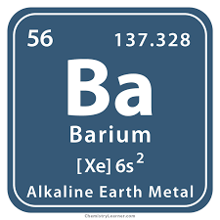
Uranium Fission
Fission of one U-235 nuclei
~2 neutrons
170 MeV of energy
Ordinary chemical reactions produce around 5 ev
Notes:
Uranium is smallest fissile element and makes lots of energy which is good cuz make big bomb small size :) also releases 2 meutrons which is important to sustain rxn

Slide 6
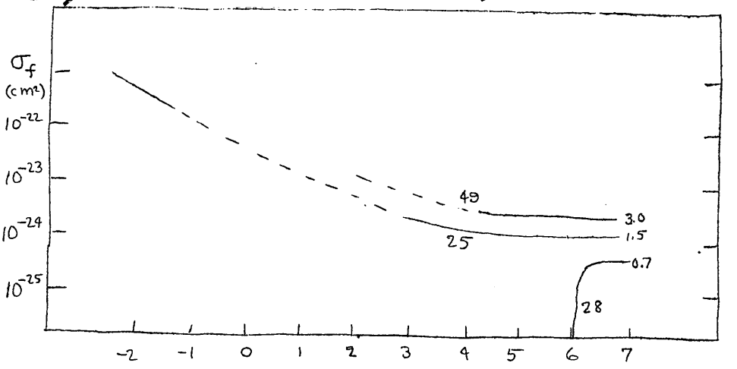

Fast Neutron Chain Reaction
Fission cross section vs. neutron energy
- Plots of Plutonium Pu-294, U-235, and U-238
- U-235 at slower speeds
- U-238 (ordinary uranium)
- Plutonium at all speeds is more fissile
- Uranium bomb needed to be at least 60% U-235

Slide 7
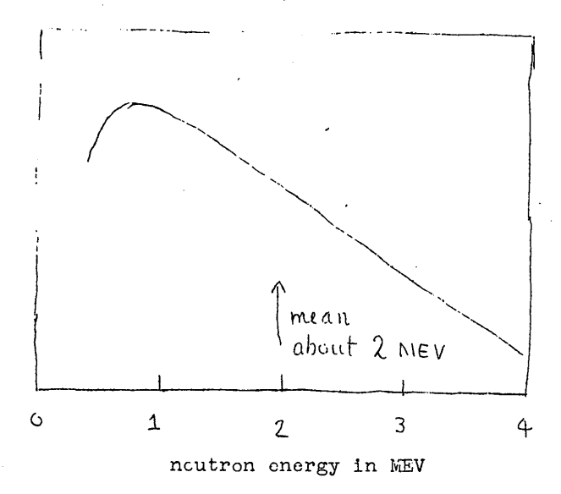

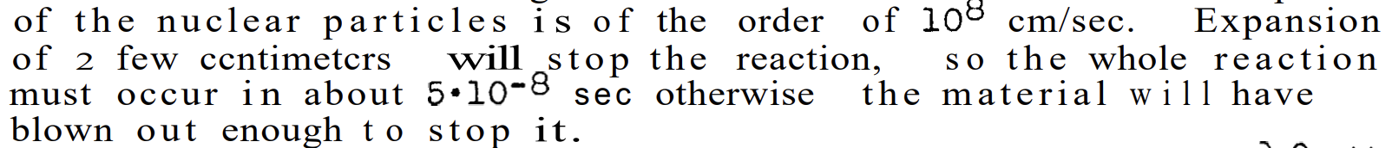
Fast Neutron Chain Reaction
- Speed of neutrons released in fission
- They were on average fast
- Neutrons under 1 MeV could not fission U-238
Number of neutrons produced:
Time of reaction and time between fissions

Slide 8
Logistics of Bomb Making

Slide 9
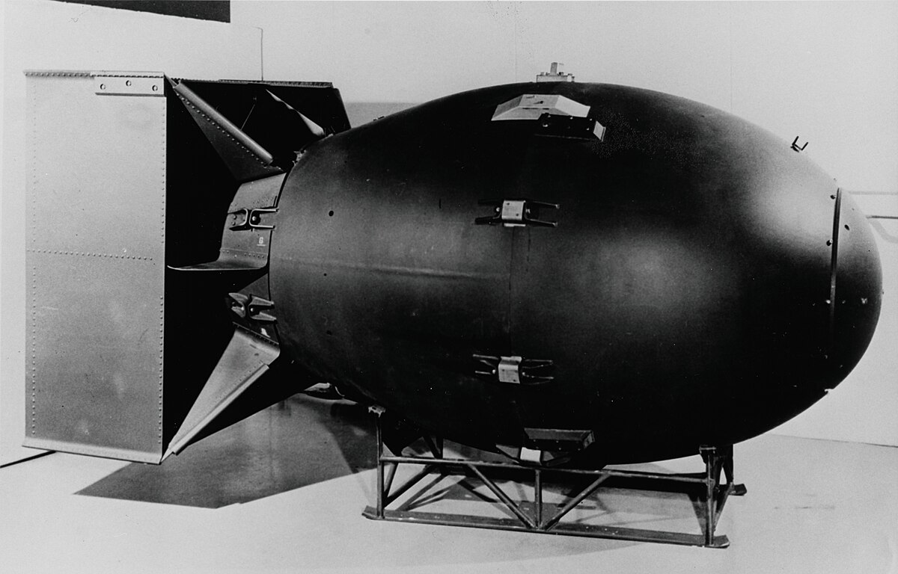
Critical Mass and Diffusion Theory
Critical mass is the minimum amount of fissile material needed for a nuclear chain reaction to sustain itself.
Why care about mass? Shape?
Theoretical calculations gave a 200kg minimum mass for U-235.
Diffusion Theory is an estimation of neutron behavior within a chain reaction
Tampering

Slide 10

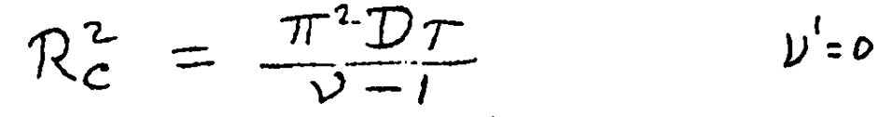


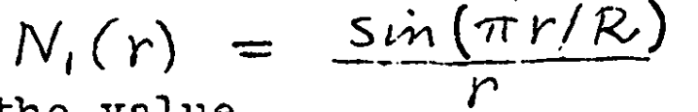
Critical Mass Derivation
Neutron diffusion equation used in calculations: D is diffusion constant, N is the number of neutrons in unit volume,
Critical radius assuming
Solution to differential equation
Some algebra and consideration of density allows us to determine critical mass
Assuming a spherical bomb

Slide 11
Predetonation
Likelihood of fission pieces reacting prematurely
Wanted to minimize surrounding neutrons to avoid the risk of early fission before actual bomb explosion
Determined there was a 15% chance of predetonation
Neutrons would come from
Cosmic Ray Neutrons
Spontaneous fission
Nuclear reactions (α,n) reactions of lighter elements in impurities
Notes:
Factors include material expanding, density decrease, neutron production rate

Slide 12
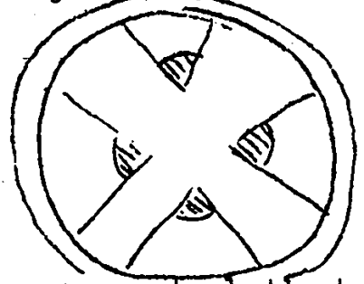
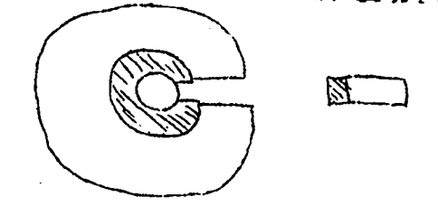
Detonation Strategies
Uranium
Plutonium

Slide 13
Efficiency and Damage
They were not expecting all the material to fission
Reaction is limited by many factors
Tamper increases efficiency through neutron insulation and slowing expansion
Hiroshima bomb efficiency
  less than 2% of uranium reacted, only 0.7 grams of mass transformed into energy.
Notes:
Factors include material expanding, density decrease, neutron production rate

Slide 14

Thanks For Listening!

